Slide 1
How to Successfully Leverage Professional Associations
Anna Carlin, CISA Fullerton College

Slide 2
Agenda
Purpose of Professional Associations
Professional Association Benefits
ISACA Professional Association
ISACA Model Curricula
ISACA Academic Advocate
Student Groups
Certifications
Questions

Slide 3
Professional Associations
Further a profession such as cyber security
Facilitate entry into the profession
Create and maintain standards
Represent the profession in discussions with other bodies such as legislative or regulatory bodies

Slide 4
Benefits
Curriculum
Invite them to be on your advisory board
Guest speakers to your classes
Student clubs
Discount membership
Discounted dinner meetings
Speakers for club meetings
Certifications

Slide 5
ISACA Professional Association
Provides guidance in the growing field of auditing controls for computer systems
Membership of 140,000 worldwide
Model Curricula
Academic Advocate
Student Groups
Certifications

Slide 6
ISACA Model Curricula
Offers educators curriculum development support and outline the academic training that prepares students for entry-level positions in the industry
Graduates of programs that are designated to be in alignment with the ISACA Model Curricula qualify for one year work experience toward the related CISA or CISM designation

Slide 7
ISACA Academic Advocate
Complimentary membership to faculty teaching in functional disciplines such as audit, accounting, information systems, information security, cybersecurity, enterprise governance of IT/MIS, IT risk management
Access to classroom resources
Research opportunities
Promote ISACA Student Membership and form ISACA Student Groups on campus

Slide 8
Student Groups
ISACA Student Groups are organized under university guidelines, supported by a local chapter, and officially recognized by ISACA International on their website
Campus groups can provide valuable connections for students and familiarize them with career opportunities after graduation
Presently 35 in North America, 57 additional worldwide

Slide 9
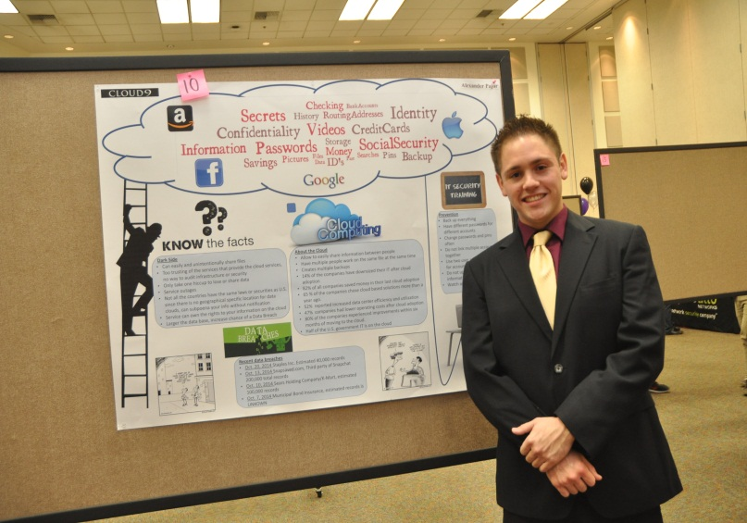
Student Groups in the Los Angeles Chapter
October Career Night
Sponsor activities
Student poster presentations
IT Competitions
Collegiate Cyber Defense Competition
CyberTech Girls
Speak at club meetings

Slide 10
Certifications
Experience and knowledge:
CISA, CISM, CGEIT, CRISC, and CSX from ISACA
CISSP, SCCP from ISC(2)
Review courses offered at a reasonable cost

Slide 11
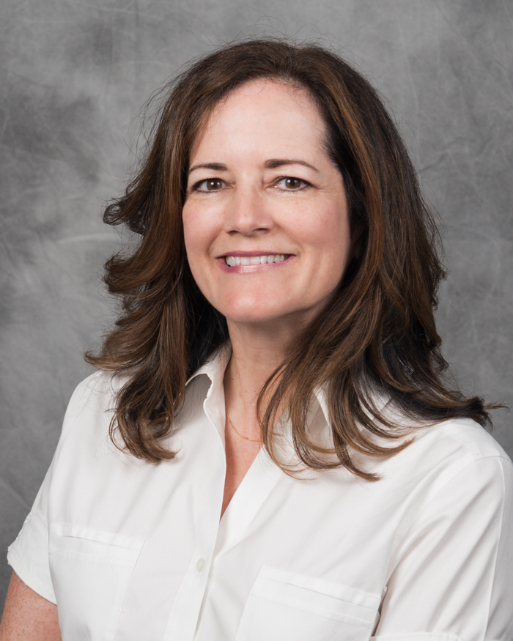
Contact Information
acarlin@fullcoll.edu
@ProCarlin

